Slide 1


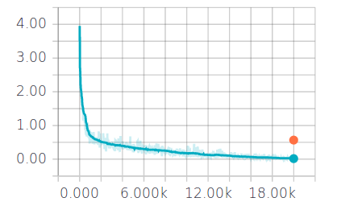
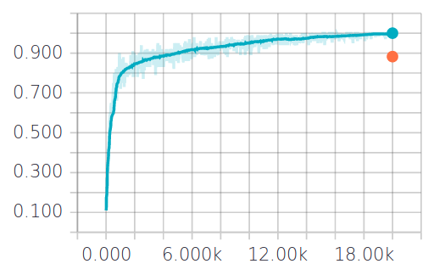
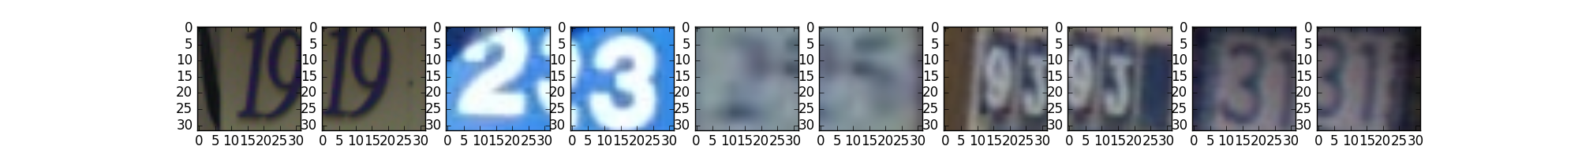
Machine learning on Street View House Numbers Dataset
Young Won Kim & Minh Pham (Team ‘Les Mignonnes’)
ABSTRACT
RESULTS
RESULTS
While recognizing texts and digits from photographs has practical real world applications, it is still a challenging computer vision problem. Machine learning, which utilizes statistical reasoning to approximate solutions for different problems, has been shown to accurately extract meaningful data from images. In this project, we attempted to classify images of house numbers from the Street View House Number dataset using different machine learning approaches. We were able to achieve high classification accuracy with neural networks, suggesting that these methods can capture crucial information from images.
Classifier | Preprocessing | Test Accuracy
Softmax | Normalized | 0.10
One-vs-All | None | 0.24
KNN | None | 0.49
KNN | Grayscale, normalized | 0.52
5-layer FC | Normalized | 0.73
5-layer FC | YUV, normalized | 0.78
2 conv + 1 FC CNN | Grayscale, normalized | 0.73
4 conv + 3 FC CNN | Grayscale, normalized | 0.86
2 conv + 1 FC CNN | Grayscale, equalized | 0.85
2 conv + 1 FC CNN | Grayscale, normalized | 0.87
Loss
Validation
Training
A.
Iterations
Accuracy
Validation
Training
B.
METHODS
Neural network methods outperformed non-neural ones
We started with non-neural network methods, namely KNN, OVA, and Softmax. Of them all, KNN was the best performing method, with 0.52 classification accuracy. We moved on to neural networks with FC and CNN. Overall, neural networks yielded higher test accuracies (0.73 - 0.87), although CNN performed slightly better.
Data Acquisition
Street View House Number (SVHN)
Small cropped digits in RGB colors
A training set: 73257 images
A test set: 26032 images
Image Preprocessing
Grayscale conversion
YUV conversion
Histogram equalization
Normalization
Classifier Algorithms
Non-neural network approaches:
One-vs-All (OVA) logistic regression
k-nearest neighbors (KNN)
Softmax
Neural network approaches:
Fully connected neural networks (FC)
Convolutional neural networks (CNN)
(used TensorFlow, an open source software library)
Iterations
Loss (A) decreased and accuracy (B) increased as the number of iterations increased.
Plotting the training loss (A) and accuracy (B) (blue lines) showed that the model was indeed learning over the training set. Validation accuracy (B) (orange dot) of 0.88 suggests that the model had high predictive power on unseen samples.
Input
CONCLUSIONS
Output
Data preprocessing improved classification accuracy
Neural network approaches outperformed non-neural network methods in classifying digit images in SVHN
Architecture choices and hyperparameter tuning in CNN are crucial for classification success
5x5 32 filters
ReLU
2x2 max pooling
3x3 64 filters
ReLU
2x2 max pooling
FC with
1024 neurons
Dropout
ADAM update rule
Loss layer
Softmax
Architecture of the best performing CNN
Our best network consists of two repeats of [Conv - ReLU - Pool] layers. Both of these Conv layers use stride = 1 and automatic zero padding so that the output size will remain the same. After the two Conv layers, we implemented one FC layer. Using this three-layered CNN allowed us to reach 0.88 as validation accuracy and 0.87 as test accuracy.
ACKNOWLEDGEMENT
TensorFlow
CS540: Statistical Machine Learning course materials

